Slide 1
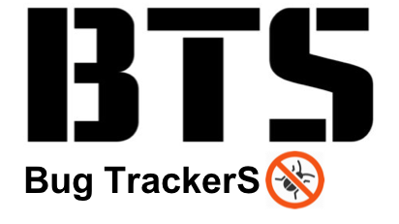
- Final Presentation -

Slide 2



Who is BTS?
More famous Koreans than Kimchi and Psy (Gangnam Style)
324 / 1000000 - according to newspaper in 2015.
Self Verification
The group's 2018 album, LOVE YOURSELF 轉 'Tear', debuted at No. 1 on the Billboard200
and No. 10 on the BillboardHOT100 , marking the highest rank as Asian artist in history
2017 and 2018 Billboard Music Awards BBMAs - Top Social Artist

Slide 3

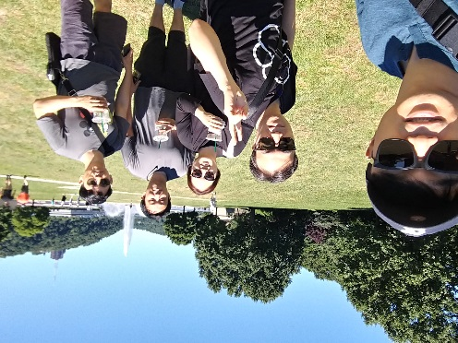
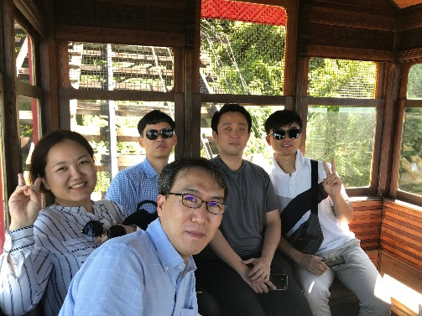
Team introductions
사진 cliff 함께 찍은걸 추가
이C. : 관련 내용 추가 /변경
Team Goal
“Understanding of SDET Culture and Techniques”,
not dancing or singing like BTS.
Team member / Main Role
Clifford C Huff / Mentor
Sungho Chin / Team & Project Lead
Jonggoo Lee / Code Review Lead
Sujung Lyu / Refactoring Lead
Jinhyuk Yang / Static Analysis Lead
Hyoyeon Hwang / Plan & Test Lead
Ground Rules
Every member should be involved in every quality management process.
5h for project / day, 1 project meeting / day, 1 mentoring meeting / week

Slide 4
Project introductions
프로젝트 goal 변경
Quality goal 을 정의
Measure 정의
이C
Project Goal
Making Bug-free Game. (at least No Major, Critical defects)
Focus on testability
not focus on simple coverage ratio
Quality Goals
Testability : line coverage : 90%, branch coverage : 80%, mutation coverage : 90%
Function’s Logical Correctness : Unit Test - pass 100%
Function’s suitability for new features : 60%
Usability (optional) : improve game command and message visibility (can be play the game with the less use ‘help’ command)
Discussion of collected data : team Wiki, JIRA, Sonar, GIthub
프로젝트 goal(quality goal 포함)
목표대비/달성도 비교 추가
Quality activity 의 경험하고 현업에 적용
System test case 추가
개발 feature 를 세분화하고 pass율 작성
비기능 – 서버 동시 접속 내구성 테스트

Slide 5
Project Risk Management (to be edited)
황S
Project Risk
기술적 리스크
명확하지 않은 요구사항 : 요구사항을 보충해나갔다는 식으로 풀어간다.
자원 리스크
리소스 위주로 풀어나간다. : 한정된 리소스에서 프로젝트를 진행하기 위해 테스트 / 개발자를 나눔
Product Risk
제품 품질 리스크
신규 기능에 따른 integration 과정에서 의도치 않은 많은 오류가 발생. : integration Test뿐만아니라 사용자 입장에서 System Test도 동시에 진행하여 버그를 발견할 수 있도록 노력한 부분 풀어나갈것.
Risk management 추가
- Project & Product 관점에서 기술
요구사항 명확하지 않음 -> 요구사항 보충 진행
java language 에 익숙하지 못함 -> 난이도에 따라 개발 업무 분장
자원 리스크 – 프로젝트 매니지먼트 툴 결정에 시간 소비가 많았음 -> 제약이 없는 서비스 사용 (외부jira)
팀원 모두가 사용이 용이한 툴

Slide 6
Project Results - Quality activities
유C
용어 기준
Static Analysis
SonarQube
Code Review
Team (Technical) Review
Refactoring & Rework
Static Analysis
Unit Test / Mutation Test
White Box testing (statement testing, branch testing)
JUnit4, Mockito, jacoco, PITest
Integration Test
Scenario testing (Gray box testing)
JUnit4, Mockito, jacoco
System Test
Scenario testing, Ad-hoc testing, Combination testing, Boundary Value Analysis

Slide 7

TBD Project Plans (?)
진C
용어 통일
Actual 선 굵게
actual

Slide 8
Project Management
진C
Values for Project
PV(Planned Value) : planned effort(h) for our project
EV(Earned Value) : estimated effort(h) for each activities
AC(Actual Cost) : actual executed effort(h) for each activities
주말 빼기, 시스템 테스트 추가

Slide 9
Project Results - Defect Categorization
이C
Definition of Severity
Severity | Category | Defect Types
Critical | Functionality | Conflict to requirements
 | Reliability | Cirtical unstable issue. (can't proceed game)
Major | Maintainablity | Structural Odd Code (no consistant with other code)
 | Maintainablity | Static Analysis critical issue
 | Reliability | Memory handling issue
 | Functionality | Strange functional Operation
Minor | all defects except Critical, Major defect
Severity 정의
Lessen & learned.(?)
- 각 단계별로 severity 를 다르게 정의해야 하는가
Not Actual Data

Slide 10
Project Results - Defect Categorization
이C
Not Actual Data
- 단계별-severity 데이터 합치기
- 단계별 effort
Method / Tool with Severity
Lesson learn 추가
Defect 찾는 효율

Slide 11
Quality activities – Static analysis (To be added)
양S
Goal
동적 테스팅보다 적은 effort 으로 결함 발견
CI 환경에 툴을 포함시켜 수시로 결함 분석
Resource
~~
Outputs
number of Defects : 110
Lessons Learned
~~
.
관련 내용 추가
False alarm 분석
정적 분석 툴에 대한 특성 비교
Pmd 현재 버전 돌려서 sonar 랑 비교
False alarm 개수 - print

Slide 12
Quality activities - Code Review
유C
Goal
Understanding system of Tartan Adventure.
checking correspondence between Spec. and Code
detecting Code defect
Resource
Planned Effort: (6/21 ~ 26) 50h (2h * 5days * 5 members)
Actual Effort : 36.5h
Outputs
number of Defects : 21
Lessons Learned
Vague requirements made code review hard.
Code review is one of good way to understanding System.
숫자 현행화
Lesson & learned.수정
표 교체

Slide 13
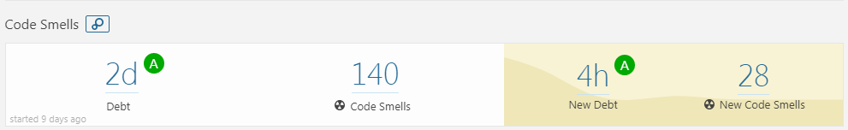
Quality activities - Refactoring & Re-Work (To be edited)
양S
- 결과물을 선명하게 나타낼 수 있는 그림 or 지표 추가가 필요함
Goal
Improving Testability
Improving Code smells in SonarQube (by 1day debt)
Resource
Planned Effort: (7/9 ~ 13) 50h (2h * 5days * all members)
Actual Effort : 31h
Outputs
Refactoring status : number of refactoring items (69) (ref. appendix.1)
SonarQube trend: (ref. appendix.2)
Lessons Learned
Refactoring is indispensable for Testability
Monitoring method for Field Status is needed to know changed status.
- For this, We discussed for changing private fields to public fields
- Finally, we added getter & setter methods.
Method should return about that’s result of procedure.
Defect category (severity) 추가

Slide 14
Quality activity – Unit test (To be edited)
양S
Goal : Satisfying code coverage
Completion criteria
90% statement coverage
80% branch coverage
Resource
Planned Effort : 45h (7/16~20, 3 hours a day, all members)
Actual / estimated Effort : 64h/73h
Outputs (ref. appendix.4)
number of unit-test : 241
coverage : statement coverage : 88%, branch coverage : 85%
Defect list : 4 (SDET-47, SDET-48, SDET-51, SDET-54)
Lessons Learned
Should simple code be included in the Unit test?
→ Our team's decision: don’t include
To effectively write the Unit test, we need a detailed specification.
- Goal 변경
* unit 단위의 기능확인 및 defect 검출
Lesson & learned
Defect 숫자가 적은 이유를 기술
Coverage 결과 업데이트
Defect category (severity) 추가
1)
요구사항 만족보다는 coverage 위주로 진행하다보니 defect 이 적게 나옴
1) methods without conditional statements, getter/setter methods
Notes:
예상 질문
유닛테스트 작성을 위해 디테일한 스펙을 정리 했는가?

Slide 15
Quality activity – Mutation Test (added)
황S
Goal : Satisfying Mutation coverage
Goal Coverage
80% line coverage 80% mutation coverage
Resource
Planned Effort : 5h (7/23, 1 member, 5 hours)
Estimated Effort : 10h (7/23, 2 members, each 5hours)
Actual : 11h (7/23 , 2 members, 6hours + 5hours )
Outputs (ref. appendix.5)
Mutation Test Result Report (PIT Summary)
Lessons Learned
Improvement of Mutation coverage was not directly related to improvement of Unit Test defect detection. (actually, we could not find a bug in the actual program due to the test case change by the mutation test.) → Rather than increasing mutation coverage, it is important to selectively handle the remaining test case bugs provided by the PIT.
We could see that explicit unit test case implementation of the parts to be checked and the degree of stub processing affected the mutation coverage.
Lesson learn 요약
우리는 효과가 없었지만..
일반적으로 효과적으로 사용되는 곳
we did mutation test before implement new feature
Notes:
예상 질문
유닛테스트 작성을 위해 디테일한 스펙을 정리 했는가?

Slide 16
Quality activity – Integration test (To be edited)
황S
Goal : Merge the new features into one repository and verify that they are working properly.
Completion criteria
Test case result : 100% pass
Resource
Planned Effort : 45h (7/18~20, 2hours a day, all members) -> 19h 30m
Actual Effort : 15h 40m
Outputs
Test case : 11 (ref. appendix.5 )
pass rate : : 100 %
Defect list : 1 (SDET-46) (appendix. 5)
Lessons Learned
In the tartan project, the modules are already integrated, should we do the integration test?
New feature integration test case 및 defect 기준으로 수정
New feature 내용 위주로 재구성
기존 내용은 effort. 관련된 데이터 위주로 재사용
Notes:
예상 질문

Slide 17
Quality activity - System test
유C
Goals
Verify requirements from the user's perspective.
Especially, Use-Cases will be mainly validated.
Completion criteria
Test case cover : 100%
Resource
Planned Effort : 40 hours (4Cycle / 5 hours per dycle / 2 members)
Actual Effort : 35
Outputs
Test case : 492(appendix. 7)
cover rate : 100 %
Defect list : 30 (appendix. 5)
Lessons Learned
Ambiguous requirements and unexpected gaming behavior made code review hard.
Output 정리 필요
진행중
Scenario : 29, Action/Item : 434, Game Config. : 29
시나리오 : palyer와 designer의 시나리오 흐름도를 기반으로
시나리오의 시작에서 종료까지 path를 타도록 TC를 생성
Action/Item : 게임 진행시 필요한 세부 동작에 대한 test case. 모든 아이템(29개)의 action(14)을 실행하고, 추가로 item 없는 action에 대해서도 test하기 위한 tc 생성
Game Config. : designer의 시나리오과 관련 있음. 디자이너가 만든 게임의 valid 를 check 하는것에 대한 세부 TestCase를 분리한것.
진행중

Slide 18
New Feature Architecture
진C
Requirement
dsfd
Requirement 대비 개발 숫자
상세 requirement 는 유첨으로 정리

Slide 19
Tools
CI : Github + Jenkins (http://40.74.87.221:8080)+ sonaQube
Source repository : github (https://github.com/sunghochin/TartanAdventure)
Quality Tool : SonarQube (http://40.74.87.211:9000/projects)
document configuration : wiki page (https://sdet-bts.atlassian.net/wiki/spaces/SDET/overview)
issue tracker : jira (https://sdet-bts.atlassian.net/secure/RapidBoard.jspa?projectKey=SDET&rapidView=1)
Coverage library : jacoco, pitest
Auto trigger build
Static analysis
build
Coverage integration
source commit
Measure coverage

Slide 20
Q&A
Thank you for your attention!!

Slide 21
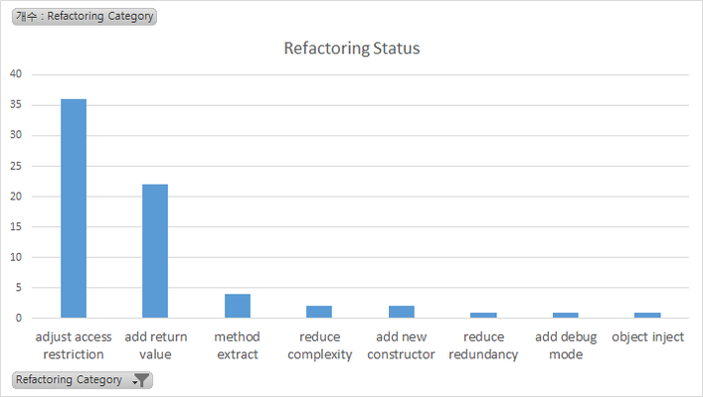
Appendix 1. Refactoring & Re-Work
Refactoring Status
Category | num | Graph
adjust access restriction | 36
add return value | 22
method extract | 4
reduce complexity | 2
add new constructor | 2
reduce redundancy | 1
add debug mode | 1
object inject | 1

Slide 22
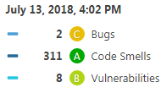
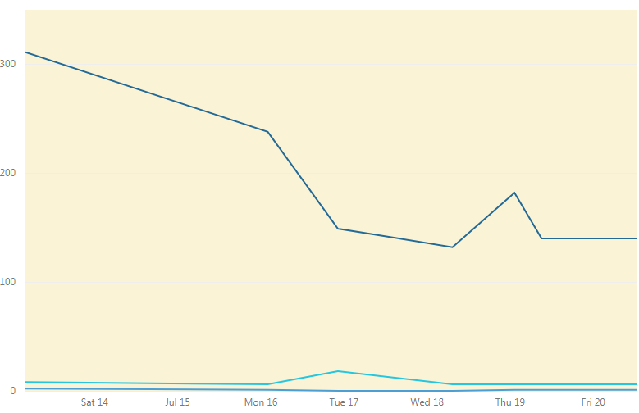
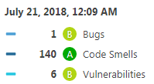
Appendix 2. Refactoring & Re-Work
SonarQube Trand

Slide 23
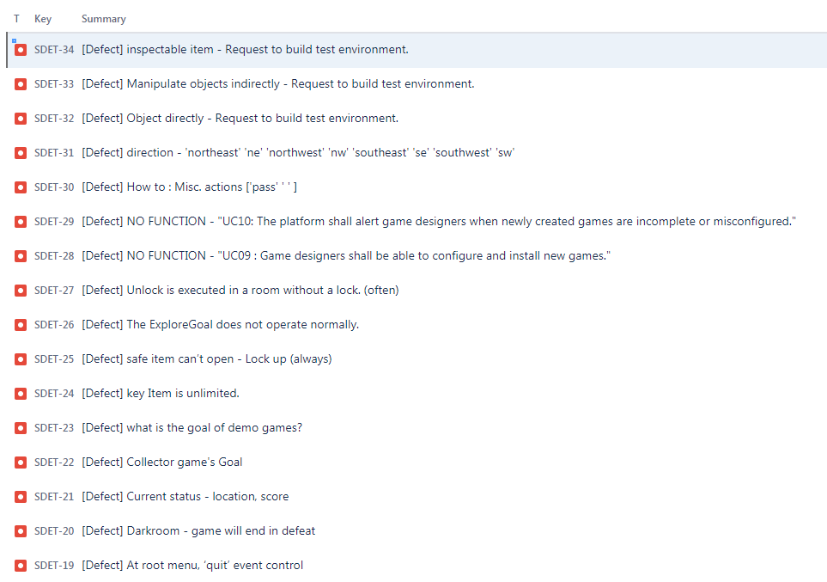
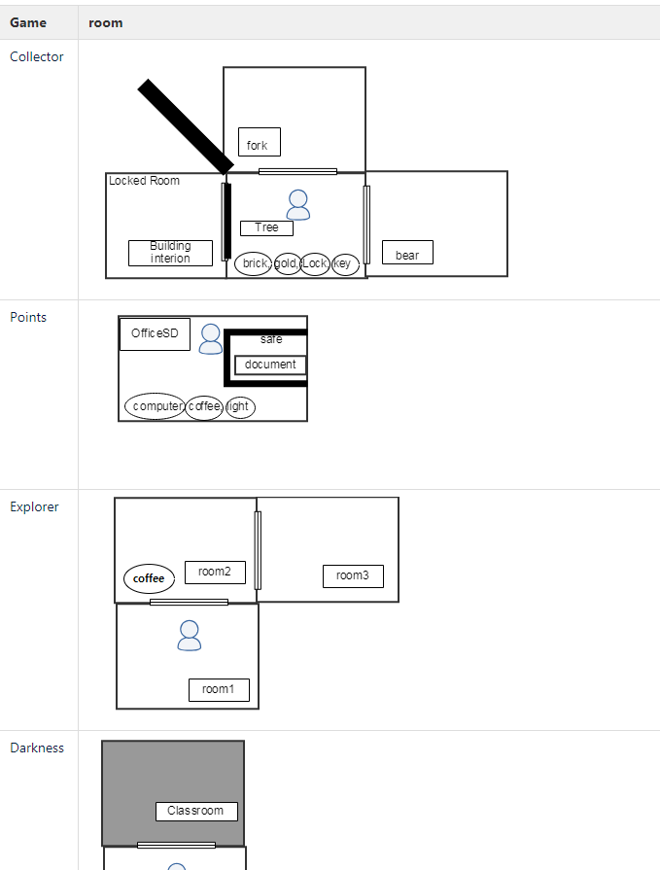
Appendix 3. Pre-Test outputs
Defect : 16
Game Map

Slide 24
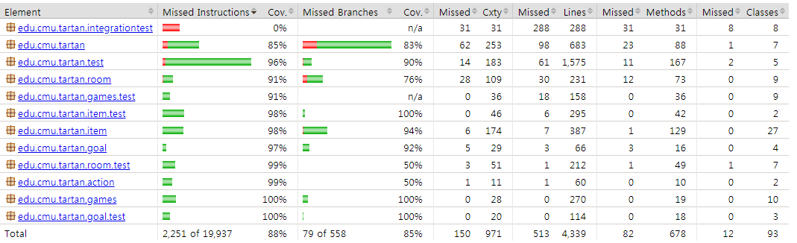
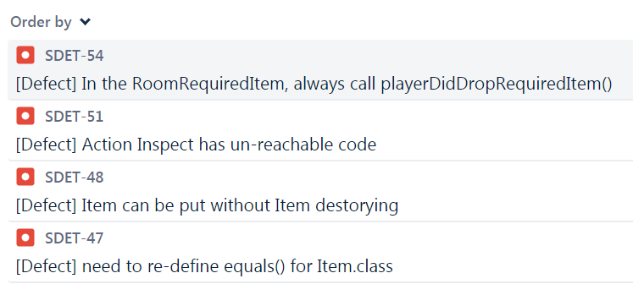
Appendix 4. Quality activity – Unit test
Coverage
Defect list
Notes:
예상 질문
유닛테스트 작성을 위해 디테일한 스펙을 정리 했는가?

Slide 25
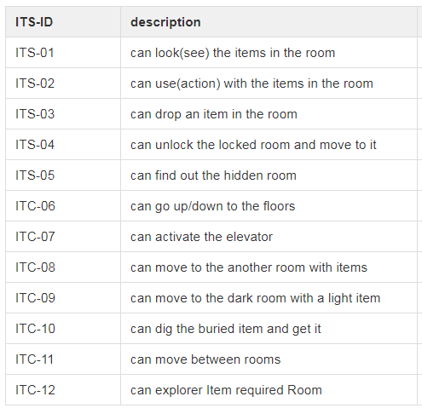
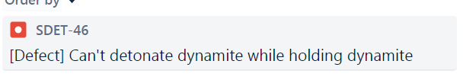
Appendix 5. Quality activity – Integration test
Test case
Defect list
Notes:
예상 질문

Slide 26
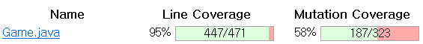
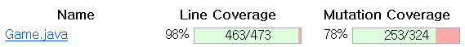
Appendix 4. Quality activity – integration test
Before Coverage
After Coverage
Notes:
예상 질문
유닛테스트 작성을 위해 디테일한 스펙을 정리 했는가?

Slide 27
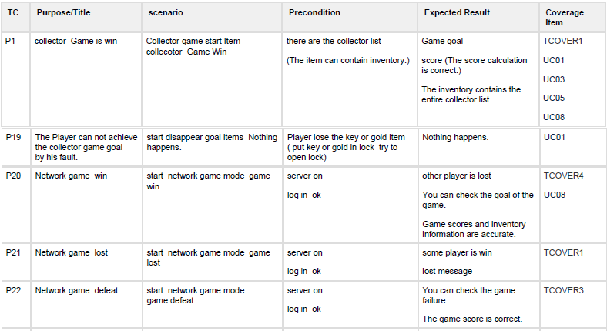
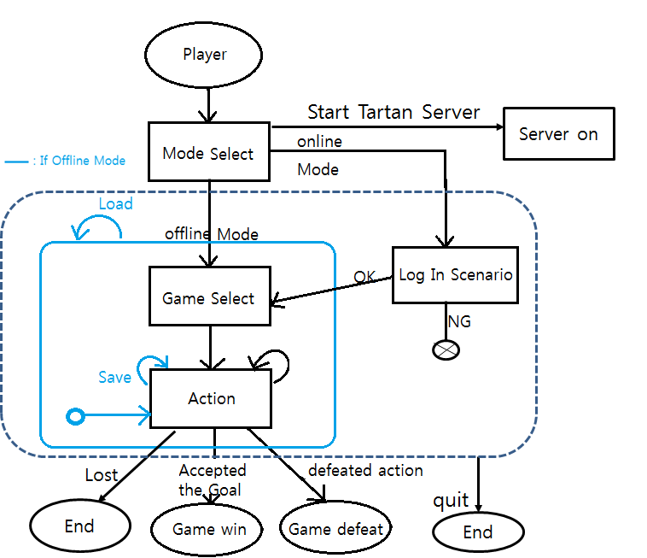
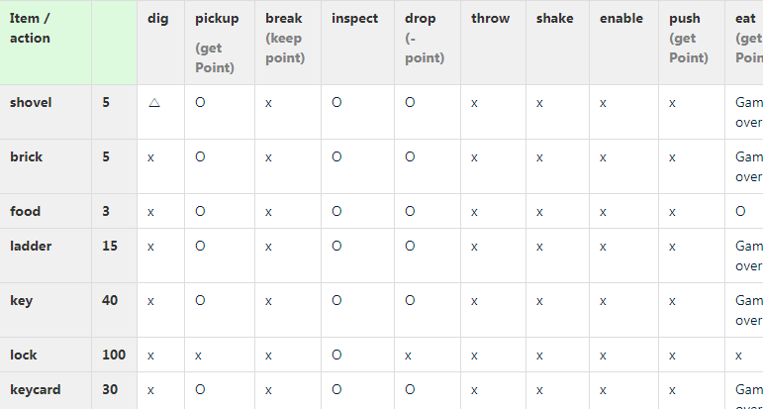
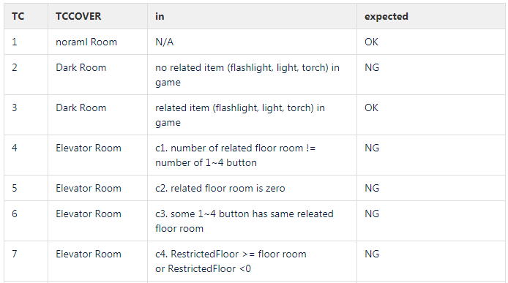
Appendix 7. Quality activity – System Test TC
Scenario
Action & Item
Game Config.
Notes:
예상 질문

